Slide 1
MULTILEVEL ASSOCIATION RULES

Slide 2
Multilevel Association Rules
It is very difficult to form association rules at the low level of abstraction as data scarcity is there. Also resultant rules can not efficiently used.
Using concept hierarchies, transaction data can be represented at various levels of abstraction.
In Multilevel Association Rules, association rules are generated at multiple levels of abstraction
Instead of going at lower level of abstraction, association rules are generated from higher level of abstraction which represents common sense knowledge and be used efficiently

Slide 3
Need of Multiple –level Association Rules?
Sometimes at low data level , data does not show any significant pattern. But there are useful information hiding behind.
Aim is to find the hidden information in or between levels of abstraction
Three Ways
Uniform Support ( Using uniform minimum support for all levels )
Reduced Support ( Using reduced minimum support at lower levels )
Group-Based Support ( Using Item or group based minimum support)

Slide 4
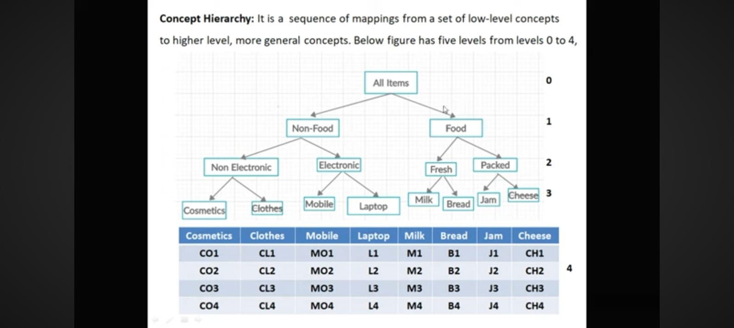

Slide 5
Concept hierarchy: It is a sequence of mappings from a set of low level concepts to higher level, more general concepts. Figure has five levels from levels 0 to 4.

Slide 6
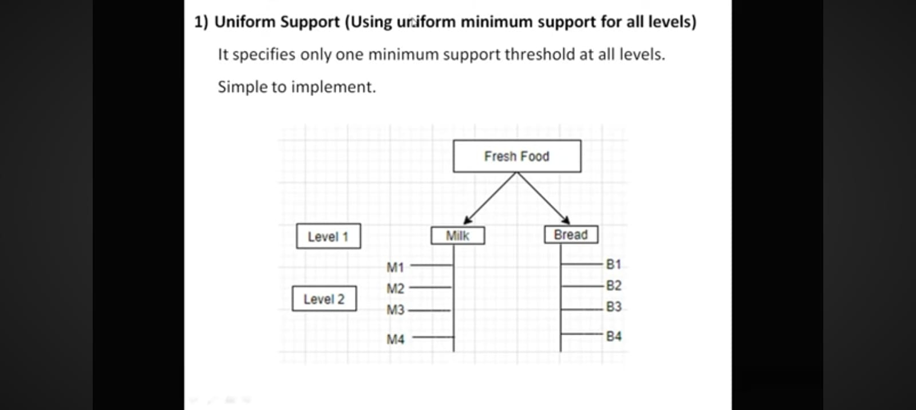

Slide 7
LEVEL 2
LEVEL 1
TID | Items
T1 | M1, B2
T2 | M2, B1
T3 | B2
T4 | M3, B1
T5 | M2
TID | Items
T1 | Milk, Bread
T2 | Milk, Bread
T3 | Bread
T4 | Milk, Bread
T5 | Milk

Slide 8
LEVEL 2
LEVEL 1
TID | Items
T1 | M1, B2
T2 | M2, B1
T3 | B2
T4 | M3, B1
T5 | M2
TID | Items
T1 | Milk, Bread
T2 | Milk, Bread
T3 | Bread
T4 | Milk, Bread
T5 | Milk
Case 1 : Minimum Support = 20% i.e. 1
Case 2 : Minimum Support = 40% i.e. 2
Case 3 : Minimum Support = 50% i.e. 3

Slide 9
1) Uniform Support ( Using uniform minimum support for all levels )
It specifies only one minimum support threshold at all levels. Simple to implement.

Slide 10
Drawback:
If the Minimum support threshold is set too high, it could miss some meaningful associations occurring at low abstraction levels.
If the threshold is set too low, it may generate many uninteresting associations occurring at high abstraction levels .

Slide 11
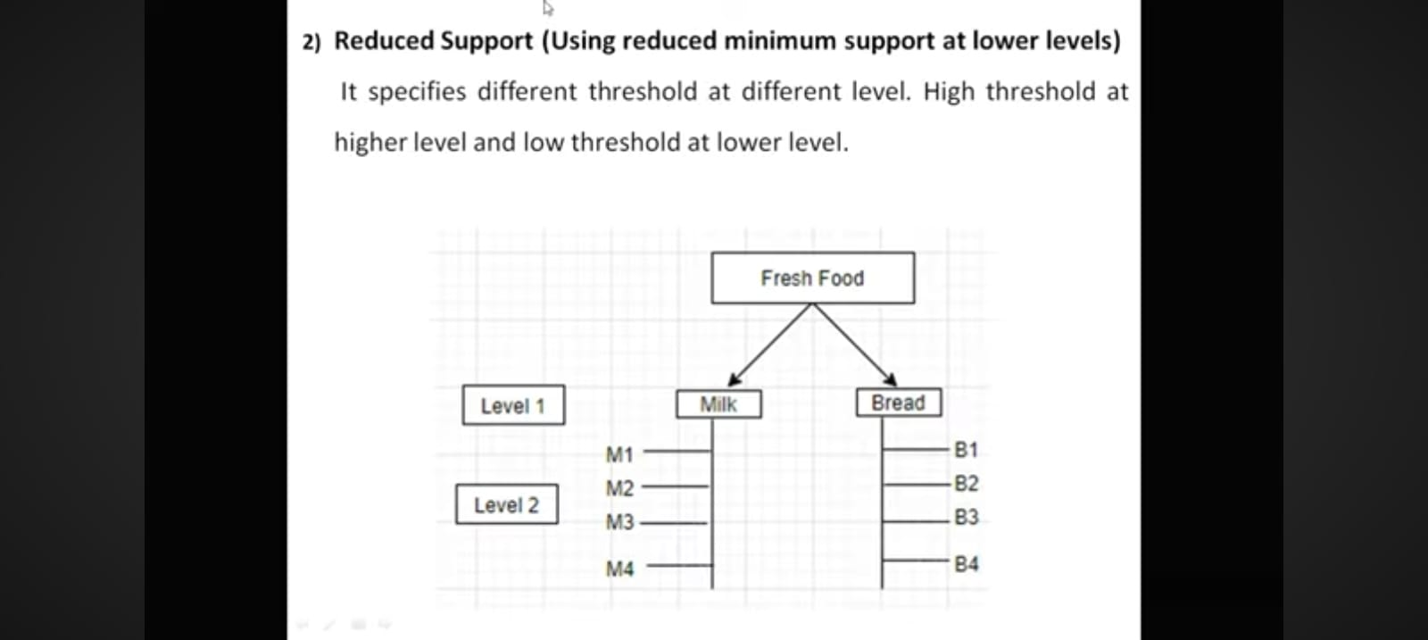
2)Reduced Support (Using minimum support at lower levels)
It specifies different threshold at different level.
High threshold at higher level and low threshold at lower level.

Slide 12
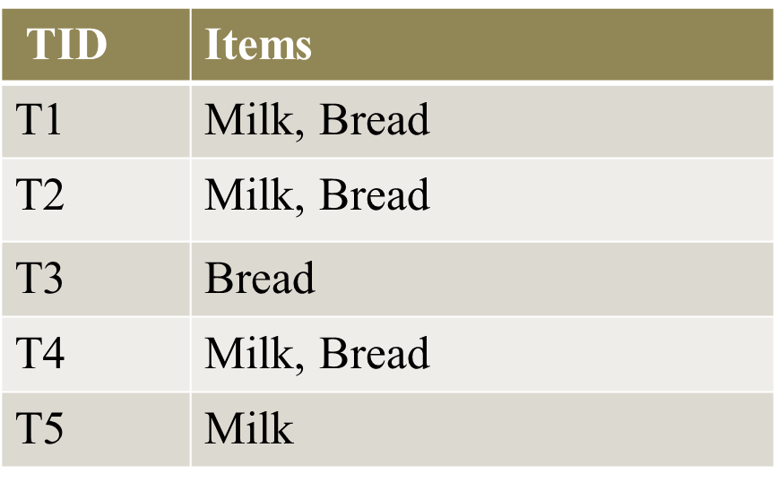
LEVEL 2
LEVEL 1
TID | Items
T1 | M1, B2
T2 | M2, B1
T3 | B2
T4 | M3, B1
T5 | M2
LEVEL 2 : Minimum Support = 40% i.e. 2
LEVEL 1 : Minimum Support = 50% i.e. 3

Slide 13
3) Group- Based Support(Using item or group minimum support)
Group wise threshold value for support and confidence is input by the user or expert.
Group is selected based on product price or item of interest.
Experts have insight as to which groups are more important than others .
For eg. Experts are interested in purchase pattern of laptop and cloths in non and electronic category therefore low support threshold is set for this group to give attention of these items purchase pattern.

Slide 14
MULTIDIMENSIONAL ASSOCIATION RULES

Slide 15
TID | Items
T1 | Milk, Bread
T2 | Bread, Butter
T3 | Beer
T4 | Milk, Bread, Butter
T5 | Bread, Beer
T6 | Milk, Bread, Butter

Slide 16
Apply Apriori
Min Support : 3
TID | Items
T1 | Milk, Bread
T2 | Bread, Butter
T3 | Beer
T4 | Milk, Bread, Butter
T5 | Bread, Beer
T6 | Milk, Bread, Butter
 | I1 | I2 | I3 | I4
1. | P | P | A | A
2.
3.
4.
5.
6.

Slide 17
Apply Apriori
Min Support : 3
TID | Items
T1 | Milk, Bread
T2 | Bread, Butter
T3 | Beer
T4 | Milk, Bread, Butter
T5 | Bread, Beer
T6 | Milk, Bread, Butter
 | I1 | I2 | I3 | I4
1. | P | P | A | A
2. | A | P | P | A
3. | A | A | A | P
4. | P | P | P | A
5. | A | P | A | P
6. | P | P | P | A
TOTAL

Slide 18
Apply Apriori
Min Support : 3
TID | Items
T1 | Milk, Bread
T2 | Bread, Butter
T3 | Beer
T4 | Milk, Bread, Butter
T5 | Bread, Beer
T6 | Milk, Bread, Butter
 | I1 | I2 | I3 | I4
1. | P | P | A | A
2. | A | P | P | A
3. | A | A | A | P
4. | P | P | P | A
5. | A | P | A | P
6. | P | P | P | A
TOTAL | 3 | 5 | 3 | 2

Slide 19
Apply Apriori
Min Support : 3
TID | Items
T1 | Milk, Bread
T2 | Bread, Butter
T3 | Beer
T4 | Milk, Bread, Butter
T5 | Bread, Beer
T6 | Milk, Bread, Butter
 | I1 | I2 | I3 | I4
1. | P | P | A | A
2. | A | P | P | A
3. | A | A | A | P
4. | P | P | P | A
5. | A | P | A | P
6. | P | P | P | A
TOTAL | 3 | 5 | 3 | 2

Slide 20
Apply Apriori
Min Support : 3
TID | Items
T1 | Milk, Bread
T2 | Bread, Butter
T3 | Beer
T4 | Milk, Bread, Butter
T5 | Bread, Beer
T6 | Milk, Bread, Butter
 | I1 | I2 | I3 | I4
1. | P | P | A | A
2. | A | P | P | A
3. | A | A | A | P
4. | P | P | P | A
5. | A | P | A | P
6. | P | P | P | A
TOTAL | 3 | 5 | 3 | 2

Slide 21
Apply Apriori
(2 itemset generation)
 | I1 | I2 | I3
1. | P | P | A
2. | A | P | P
3. | A | A | A
4. | P | P | P
5. | A | P | A
6. | P | P | P
TOTAL | 3 | 5 | 3
ITEMSET | SUPPORT COUNT
I1 , I2
I1 , I3
I1 , I3

Slide 22
Apply Apriori
(2 itemset generation)
 | I1 | I2 | I3
1. | P | P | A
2. | A | P | P
3. | A | A | A
4. | P | P | P
5. | A | P | A
6. | P | P | P
TOTAL | 3 | 5 | 3
ITEMSET | SUPPORT COUNT
I1 , I2 | 3
I1 , I3
I1 , I3

Slide 23
Apply Apriori
(2 itemset generation)
 | I1 | I2 | I3
1. | P | P | A
2. | A | P | P
3. | A | A | A
4. | P | P | P
5. | A | P | A
6. | P | P | P
TOTAL | 3 | 5 | 3
ITEMSET | SUPPORT COUNT
I1 , I2 | 3
I1 , I3 | 2
I2 , I3 | 3

Slide 24
Apply Apriori
(2 itemset generation)
 | I1 | I2 | I3
1. | P | P | A
2. | A | P | P
3. | A | A | A
4. | P | P | P
5. | A | P | A
6. | P | P | P
TOTAL | 3 | 5 | 3
ITEMSET | SUPPORT COUNT
I1 , I2 | 3
I1 , I3 | 2
I2 , I3 | 3

Slide 25
Dimension represents attributes in database. 1) Single Dimensional or Intra Dimensional Association Rule
It contains a single distinct predict ( e.g purchase ) with its multiple occurrences.
For eg. purchase( X, “Milk”) purchase ( X , “Bread”)
L1 C2
 | I1 | I2 | I3
1. | P | P | A
2. | A | P | P
3. | A | A | A
4. | P | P | P
5. | A | P | A
6. | P | P | P
TOTAL | 3 | 5 | 3
ITEMSET | SUPPORT COUNT
I1 , I2 | 3
I1 , I3 | 2
I2 , I3 | 3

Slide 26
ITEMSET | SUPPORT COUNT
I1 , I2 | 3
I2 , I3 | 3
ITEMSET | SUPPORT COUNT
Milk , Bread | 3
Bread , Butter | 3
ASSOCIATION RULE | CONFIDENCE | CONFIDENCE(%)
I1 I2 | C( I1 , I2 ) / C(I1) = 3 / 3 | 100%
I2 I1 | C( I1 , I2 ) / C(I2) = 3 / 5 | 60%
I2 I3 | C( I2 , I3 ) / C(I2) = 3 / 5 | 60%
I3 I2 | C( I2 , I3 ) / C(I3) = 3 / 3 | 100%
Predefined confidence can be used.

Slide 27
Confidence = 70% Single predicate : purchase is used
purchase( X, “Milk”) purchase ( X , “Bread”)
purchase( X, “Butter”) purchase ( X , “Bread”)
For eg:
If Minimum Support = 2 , then 3 itemset combination is possible. Then following rule may generate
purchase( X, “Milk”) ^ purchase ( X , “Butter”) purchase( X , “Bread”)

Slide 28
2) Multi dimensional or Inter Dimensional Association Rule

Slide 29
2) Multi dimensional or Inter Dimensional Association Rule
It contains two or more predicate. Each predicate occurs only once .
Example
Student( X, “Yes”) ^ Credit Rating ( X , “Excellent”) buys_laptop ( X ,“Yes”)
Student( X, “No”) ^ Credit Rating ( X , “Fair”) buys_laptop ( X ,“No”)
NO. | Student | Credit Rating | Buys_laptop
1 | Yes | Excellent | Yes
2 | Yes | Fair | No
3 | No | Excellent | Yes
4 | No | Excellent | Yes
5 | Yes | Fair | No
6 | No | Fair | No
Attributes | Item
Student = Yes | I1
Student = No | I2
Credit Rating = Excellent | I3
Cedit Rating = Fair | I4
Buys_Laptop = Yes | I5
Buys_Laptop = No | I6
Minimum support = 1 P: Present A: Absent

Slide 30
NO. | Student | Credit Rating | Buys_laptop
1 | Yes | Excellent | Yes
2 | Yes | Fair | No
3 | No | Excellent | Yes
4 | No | Excellent | Yes
5 | Yes | Fair | No
6 | No | Fair | No
Attributes | Item
Student = Yes | I1
Student = No | I2
Credit Rating = Excellent | I3
Cedit Rating = Fair | I4
Buys_Laptop = Yes | I5
Buys_Laptop = No | I6
C1
I1 | I2 | I3 | I4 | I5 | I6
P | A | P | A | P | A
P | A | A | P | A | P
A | P | P | A | P | A
A | P | P | A | P | A
P | A | A | P | A | P
A | P | A | P | A | P
3 | 3 | 3 | 3 | 3 | 3
Apply Apriori

Slide 31
2 itemset generation
C2
Itemset | Count
( I1 , I2 ) | 0
( I1 , I3 ) | 1
( I1 , I4 ) | 2
( I1 , I5 ) | 1
( I1 , I6 ) | 2
( I2 , I3 ) | 2
( I2 , I4 ) | 1
( I2 , I5 ) | 2
( I2 , I6 ) | 1
( I3 , I4 ) | 0
( I3, I5 ) | 3
( I3 , I6 ) | 0
( I4 , I5 ) | 0
( I4 , I6 ) | 3
( I5 , I6 ) | 0
L1
I1 | I2 | I3 | I4 | I5 | I6
P | A | P | A | P | A
P | A | A | P | A | P
A | P | P | A | P | A
A | P | P | A | P | A
P | A | A | P | A | P
A | P | A | P | A | P
3 | 3 | 3 | 3 | 3 | 3

Slide 32
2 itemset generation
C2
Itemset | Count
( I1 , I2 ) | 0
( I1 , I3 ) | 1
( I1 , I4 ) | 2
( I1 , I5 ) | 1
( I1 , I6 ) | 2
( I2 , I3 ) | 2
( I2 , I4 ) | 1
( I2 , I5 ) | 2
( I2 , I6 ) | 1
( I3 , I4 ) | 0
( I3, I5 ) | 3
( I3 , I6 ) | 0
( I4 , I5 ) | 0
( I4 , I6 ) | 3
( I5 , I6 ) | 0
L1
I1 | I2 | I3 | I4 | I5 | I6
P | A | P | A | P | A
P | A | A | P | A | P
A | P | P | A | P | A
A | P | P | A | P | A
P | A | A | P | A | P
A | P | A | P | A | P
3 | 3 | 3 | 3 | 3 | 3
Min Support : 1

Slide 33
L2
Itemset | Count
( I1 , I3 ) | 1
( I1 , I4 ) | 2
( I1 , I5 ) | 1
( I1 , I6 ) | 2
( I2 , I3 ) | 2
( I2 , I4 ) | 1
( I2 , I5 ) | 2
( I2 , I6 ) | 1
( I3, I5 ) | 3
( I4 , I6 ) | 3

Slide 34
(3 itemset generation ) Join & Prune property: First elements must be common of two records.
C3
L2
Itemset | Count
( I1 , I3 ) | 1
( I1 , I4 ) | 2
( I1 , I5 ) | 1
( I1 , I6 ) | 2
( I2 , I3 ) | 2
( I2 , I4 ) | 1
( I2 , I5 ) | 2
( I2 , I6 ) | 1
( I3, I5 ) | 3
( I4 , I6 ) | 3

Slide 35
(3 itemset generation ) Join & Prune property: First elements must be common of two records.
C3
Itemset | Count
( I1 , I3 , I4 ) | 0
( I1 , I3 , I5 ) | 1
( I1 , I3 , I6 ) | 0
( I1 , I4 , I5 ) | 0
( I1 , I4 , I6 ) | 2
( I1 , I5 , I6 ) | 0
( I2 , I3 , I4 ) | 0
( I2 , I3 , I5 ) | 2
( I2 , I3 , I6 ) | 0
( I2 , I4 , I5 ) | 0
( I2 , I4 , I6 ) | 1
( I2 , I5 , I6 ) | 0
L2
Itemset | Count
( I1 , I3 ) | 1
( I1 , I4 ) | 2
( I1 , I5 ) | 1
( I1 , I6 ) | 2
( I2 , I3 ) | 2
( I2 , I4 ) | 1
( I2 , I5 ) | 2
( I2 , I6 ) | 1
( I3, I5 ) | 3
( I4 , I6 ) | 3

Slide 36
(3 itemset generation ) Join & Prune property: First elements must be common of two records.
C3
Itemset | Count
( I1 , I3 , I4 ) | 0
( I1 , I3 , I5 ) | 1
( I1 , I3 , I6 ) | 0
( I1 , I4 , I5 ) | 0
( I1 , I4 , I6 ) | 2
( I1 , I5 , I6 ) | 0
( I2 , I3 , I4 ) | 0
( I2 , I3 , I5 ) | 2
( I2 , I3 , I6 ) | 0
( I2 , I4 , I5 ) | 0
( I2 , I4 , I6 ) | 1
( I2 , I5 , I6 ) | 0
L2
Itemset | Count
( I1 , I3 ) | 1
( I1 , I4 ) | 2
( I1 , I5 ) | 1
( I1 , I6 ) | 2
( I2 , I3 ) | 2
( I2 , I4 ) | 1
( I2 , I5 ) | 2
( I2 , I6 ) | 1
( I3, I5 ) | 3
( I4 , I6 ) | 3

Slide 37
Itemset | Count
( I1 , I3 , I5 ) | 1
( I1 , I4 , I6 ) | 2
( I2 , I3 , I5 ) | 2
( I2 , I4 , I6 ) | 1

Slide 38
L3
(4 itemset generation ) Join & Prune property: 4 Itemset generation not possible as first two items are not same.
Select those records having I5 & I6 item as
They represent final class label .
Predefined confidence can be used .
Itemset | Count
( I1 , I3 , I5 ) | 1
( I1 , I4 , I6 ) | 2
( I2 , I3 , I5 ) | 2
( I2 , I4 , I6 ) | 1
ASSOCIATION RULE | CONFIDENCE | CONFIDENCE(%)
I1^I3 I5 | C( I1 , I3 , I5 ) / C(I1 , I3) = 1 / 1 | 100%
I2^I3 I5 | C( I2 , I3 , I5) / C(I2, C13) = 2 / 2 | 100%
I1^I4 I6 | C( I1 , I4 , I6 ) / C(I1 , C4) = 3 / 5 | 100%
I2^I4 I6 | C( I2 , I4 , I6) / C(I2 , I4) = 1 / 1 | 100%

Slide 39
Four Multidimensional rules can be obtained
Student( X, “Yes”) ^ Credit Rating ( X , “Excellent”) buys_laptop ( X,“Yes”)
2) Student( X, “No”) ^ Credit Rating ( X , “Fair”) buys_laptop ( X ,“No”)
3) Student( X, “Yes”) ^ Credit Rating ( X , “Fair”) buys_laptop ( X ,“No”)
4) Student( X, “No”) ^ Credit Rating ( X , “Excellent”) buys_laptop ( X ,“Yes”)

Slide 40
3 ) Hybrid dimensional Association rule
Like multi dimensional, association rules with two or more predicate.
Unlike multidimensional, some predicate are repeated.
NO | STUDENT | CREDIT RATING | BUYS
1 | Yes | Excellent | Desktop , Laptop
2 | Yes | Fair | Desktop
3 | No | Excellent | Laptop , Printer
4 | No | Excellent | Laptop , Printer
5 | Yes | Fair | Desktop
Student( X, “Yes”) ^ Credit Rating ( X , “Excellent”)^ Buys(X , “Desktop”) Buys( X,“Yes”)
Student( X, “No”) ^ Credit Rating ( X , “Excellent”)^ Buys(X , “Laptop”) Buys( X,“Yes”)

